Slide 1
Foxquilt’s Marketing Strategy
Name
Institution
Professor
Date

Slide 2

Content And Content Marketing
As regards content, Foxquilt’s content is up to date and worth sharing on different platforms.
The content on the company’s website explains clearly what the company does as well as what individuals would gain by belonging to the insurance company
There are however no best performing articles highlighted neither are there those that have become obsolete

Slide 3
Content And Content Marketing
There are no articles classified as those that have generated the most engagement on different social media platforms
There are also no articles on the company’s website that have been rated as the most shared on social media
The content on the website is of high quality
the existing old content is edited and therefore worth accessing

Slide 4

Social Media Performance
Foxquilt’s best performing social media platform is LinkedIn as ranked by google
Foxquitl’s Facebook page is however not as active
Very few people recommend the page
The Facebook page also has few reviews

Slide 5
Social Media Performance
The last recommendations made to the company were made a year ago.
The clips updated on the page also have very few views and likes.
The company’s Facebook page is however updated on a daily basis
Foxquilt’s twitter handle(Foxquilt den) is also active with very recent updates

Slide 6
Social Media Performance
The company’s Instagram also has many photos that are up to date and related to what the company does
The you tube channel for the company is also active and frequently
The company extensively uses LinkedIn for updates and while seeking to recruit new people into the company

Slide 7
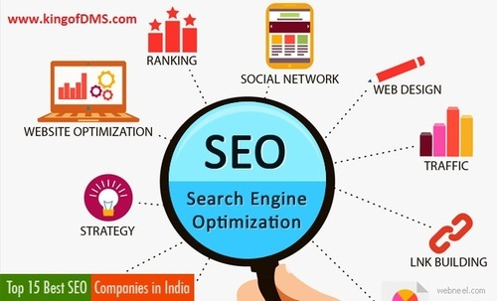
Search Engine Optimization
The company’s website ranking is second on google when one searches the company’s website
Foxquilt’s information as an insurance company is also on a higher rank on google.
Insurance for social groups in Canada is also a highly ranking keyword on google

Slide 8

Foxquilt’s Search Engine marketing
Foxquilt is one the best performing keywords on google
The company’s website does not adjust neither rewrite the website content and the site architecture upon clicking
The company’s website is not very visible in search results pages

Slide 9

On-site Optimization
The company’s website is accessible both using a mobile phone and using personal computer
All the elements of the company have been optimized on the company’s website
The company has the links to all social media platforms of the company
The website also has information on how one can contact the company

Slide 10

Foxquilt’s Website
The images on the website also load properly. the text wrapping around the images is clear and appropriate.
The company’s information is up to date
Spammy content is not available in the website

Slide 11
Foxquilt’s Website Con’t
The Foxquilts links are working. The website link is working
The Facebook link, the twitter link, the Instagram link and the LinkedIn links are all responsive upon clicking.
The website is revamped with information about the company making anyone who visits the website understand all there is about the company.

Slide 12
References
https://www.startupgrind.com/blog/the-why-and-how-of-a-digital-marketing-audit/
https://www.foxquilt.com/

